Slide 1
Upper Air BUFR Data Status
Migrating U.S. radiosonde data to BUFR
Currently, the TAC TEMP data is converted to BUFR
Resulting output is low-resolution and contains numerous conversion and metadata errors, making it of limited benefit to users
High-resolution radiosonde data is available within the RRS (Radiosonde Replacement System) software at each NWS reporting site
Data is currently only sent to NCEI for archive on delayed schedule
OPCs have requested access to this data in real-time
Expected to be of great benefit for use in NWP
A project is underway within NWS to obtain access to this data in real-time and convert it to a WMO-approved BUFR sequence for dissemination to worldwide OPCs via GTS
Project currently being managed by NCEP Central Operations
Converted data will meet WMO as well as OPC requirements
Project won’t include data from U.S. military (block 74) radiosonde sites, since those sites don’t have RRS installed
.
1
Notes:
1

Slide 2
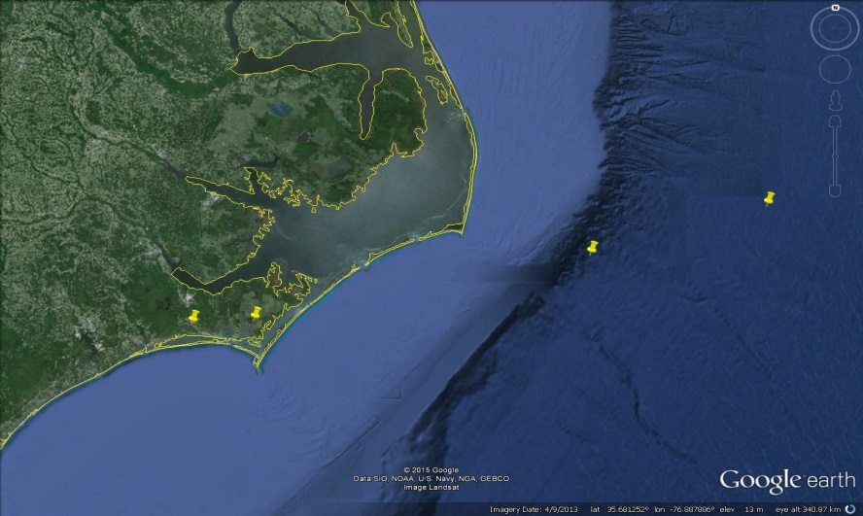
The Promise of BUFR
Non-operational high-resolution sounding for 72305 (Newport, NC) at 2015010800
BUFR: 1-sec (~5 m) data with balloon drift, all variables at all levels
6373 levels from 1020 mb to 9.8 mb
Similar to operational soundings from Europe
TAC (TEMP): mix of mandatory and significant mass/wind levels
16 mandatory, 120 significant mass, 36 significant wind levels
9.8 mb
100 mb
Launch
500 mb
Notes:
The BUFR data also have better precision than TAC—0.01K vs. 0.2K for temperature, 0.01K vs. 0.1K or 1.0K for dewpoint depression, 0.1 m/s vs. 1 kt for wind speed, 1 deg vs. 5 deg for wind direction.
Significant level winds for U.S. stations are converted from PILOT format (PPBB and PPDD) and so are in separate messages from the TEMP data.
The conversion of height to pressure for significant level winds is a source of error that is avoided in the high-resolution data. The most commonly used z-to-p conversion uses the hypsometric equation with standard atmosphere temperatures (compare squares in above figure). FNMOC uses the model background height field on pressure surfaces to provide the z-to-p conversion, which has less error than the standard atmosphere but which still has some error compared to the high-resolution data.

Slide 3
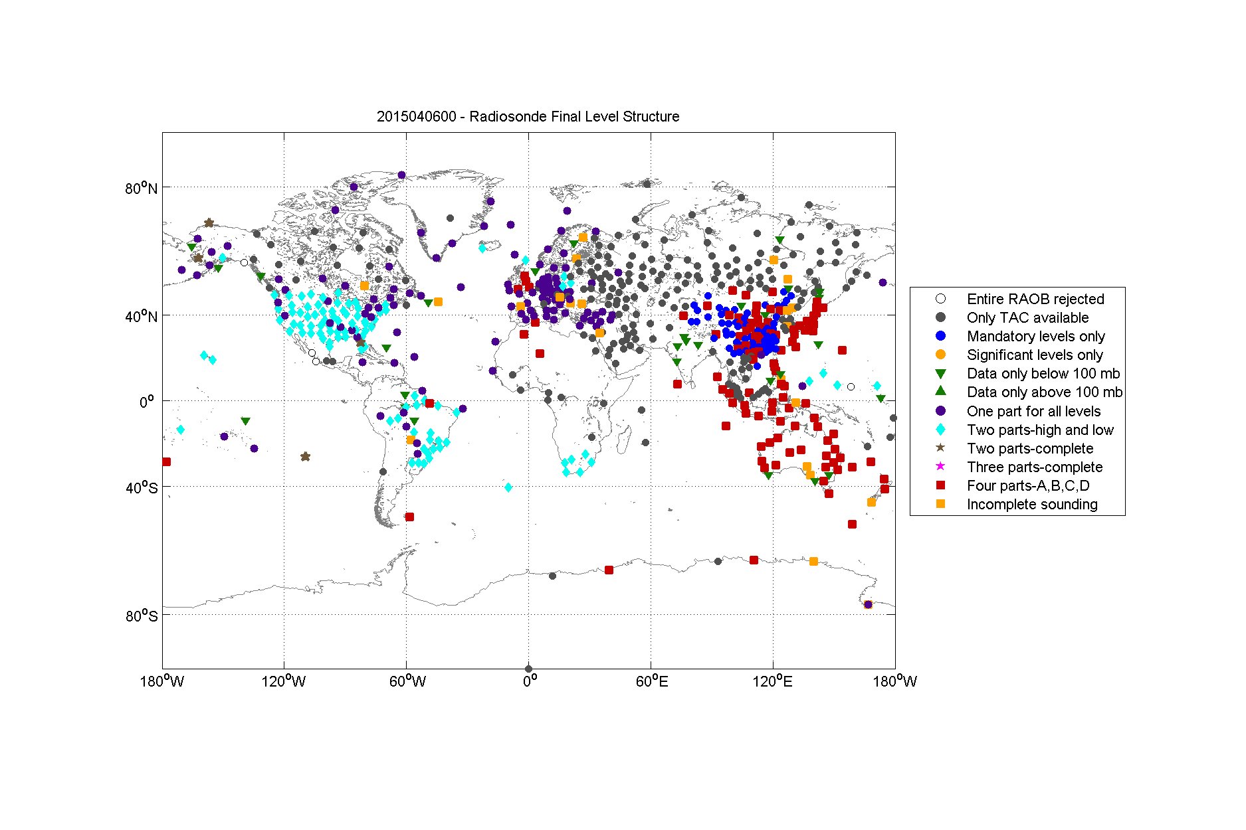
The Reality of BUFR
ECMWF, UKMO, NCEP do not plan to use BUFR by parts (red squares)
Structure of BUFR radiosonde data received at FNMOC
“Proper” BUFR—one message containing the full sounding (purple dots)
“BUFR by parts”—one message for each of the four TEMP parts (red squares)
NCO’s “legacy” BUFR uses BUFR by parts, as do New Zealand, Australia, China, Japan
NCO’s BMT BUFR provides multiple messages, some of which are proper BUFR
Notes:
Proper BUFR actually uses two messages—one is sent when the balloon reaches 100 mb, the other is sent at balloon burst.
If duplicate checking is done by message rather than by level, BUFR by parts can be difficult to use, especially when the same bulletin headers are used for more than one of the messages.
The U.S. BMT BUFR includes typically 5-6 messages, typically two IUK messages (one with just part A and one with parts A and B) and 3-5 IUS messages (one with all four parts, and often later ones with just parts B, C, and D, and with just parts C and D. Having incomplete messages in the later reports causes problems for some applications.
The duplicate check used to process the data depicted above preferentially keeps IUS messages over IUK messages and keeps messages with later receipt times over those with earlier receipt times. If an earlier message contains all four parts and a later message contains just parts C and D, the sounding post-duplicate check will contain data from both messages—low level data from the earlier message and upper level data from the later message.

Slide 4
Examples of Data Errors
Errors arising from decoding TAC prior to encoding in BUFR
Wrong leading digits for geopotential height
Negative 1000 mb heights incorrectly decoded
Various errors for tropopause level (variables mixed up, pressures wrong, etc.)
Incorrectly decoded pressure for significant levels with pressure > 1000 mb
Other errors/problems in BUFR from TAC
Negative dewpoint depressions from India
Significant level winds from Vietnam divided by two
Inconsistencies in reported time/launch time in BUFR by parts
TAC errors propagated into BUFR (e.g., pressure divided by 10 for significant winds above 100 mb from India)
Missing information
Supplemental information for dropsondes not encoded in BUFR
Significant level winds from U.S. data in separate BUFR files—converted from PPBB, PPDD PILOT format messages
Incomplete BUFR soundings with data filled in from TAC
Truncation of significant level data from Australia
Missing data above 100 mb (e.g., South Africa)
Notes:
Most BUFR radiosonde data errors occur in messages converted from TAC, typically arising from the TAC decoder.

Slide 5
Examples of Metadata Errors
Failure to convert degrees-minutes-seconds to decimal degrees
e.g., 44373 (Dalanzadgad, Mongolia)
WMO location (in degrees and minutes): 43 35N, 104 25E
BUFR location (in decimal degrees): 43.35°, 104.25°
FNMOC location (in decimal degrees): 43.58°, 104.42°
All stations in Mongolia and the Philippines have this error
Sign error in longitude
e.g., 70414 (Shemya AFB, AK): FNMOC = 174.10° ; BUFR = -174.11°
Also 60018 (Tenerife, Canary Islands), 71603 (Yarmouth, Nova Scotia)
Confusion between Hp and Hha elevations
Hp = barometer height, which should be the elevation corresponding to the surface pressure and so should be the one used for radiosonde data
Hha = either Ha (official airport altitude) or H (ground elevation)
e.g., 70350 (Kodiak, AK)
WMO VolA gives Hp = 33.8 m and Hha = 5.5 m
BUFR uses 34 m = Hp, FNMOC uses 6 m = Hha
Hydrostatic estimates of surface elevation from the lowest mandatory level height favor FNMOC
Possible adjustment made to station pressure to correct the value to Hha?
Notes:
Soundings with drift data by and large have correct metadata.

Slide 6
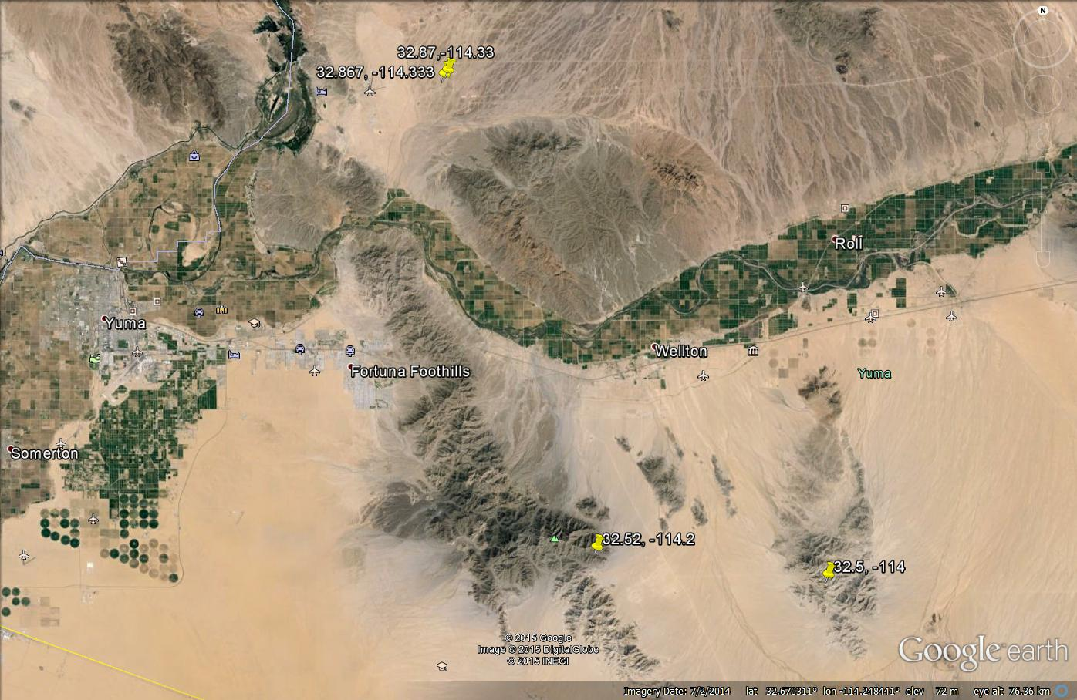
Metadata Error Example
Yuma Proving Ground (74004) is an example of a station with bad metadata in NCO’s station list and in the WMO VolA station list.
YPG: 32.87, -114.33, 131 m
FNMOC: 32.867. -114.333, 136 m
BUFR: 32.5, -114.0, 231 m
WMO: 32.5, -114.0, 231 m
The BUFR/WMO location is actually for 74005, with the latitude of 32° 50’ misinterpreted as 32.50 °.
Correct location
WMO, BUFR location
Notes:
The discrepancy between the FNMOC location and the BUFR location was reported to NCO Silver Spring on 7/11/14. At the time, the WMO station list did not even include Yuma; a January update to WMO added Yuma but with the wrong location. The correct location was obtained from YPG and reported to NCO Silver Spring on 1/20/15 (after their January update), but the 3/10/15 version of WMO VolA still lists the above values, which are also the ones used in BUFR as of 3/18/15.

